Slide 1
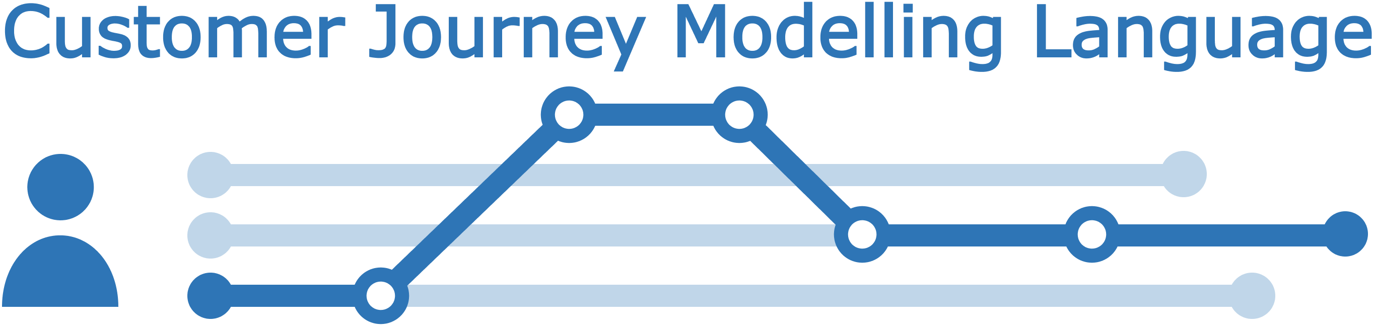
Data format – journey examples CJML - Customer Journey Modelling Language
Version 2.0
SINTEF Digital
November 2022

Slide 2


Overview of CJML 2.0 resources
Introduction
Overview, purpose and target group
Modelling approach
Visual notation
Diagrams types and symbols
Features and examples
Diagram generator
Templates for easy diagramming
Examples
The CJML material consists of several modules that are to be seen in connection to each other. All the CJML resources can be found here: www.cjml.no
Main change in this version:
An expanded terminology and a data exchange format
Change in the visual notation of the journey network diagram (message flow between sender and receiver)
Terminology
Definitions, attributes, and class diagrams
Meta-model
Data format
XML schema
XML examples
XML description

Slide 3
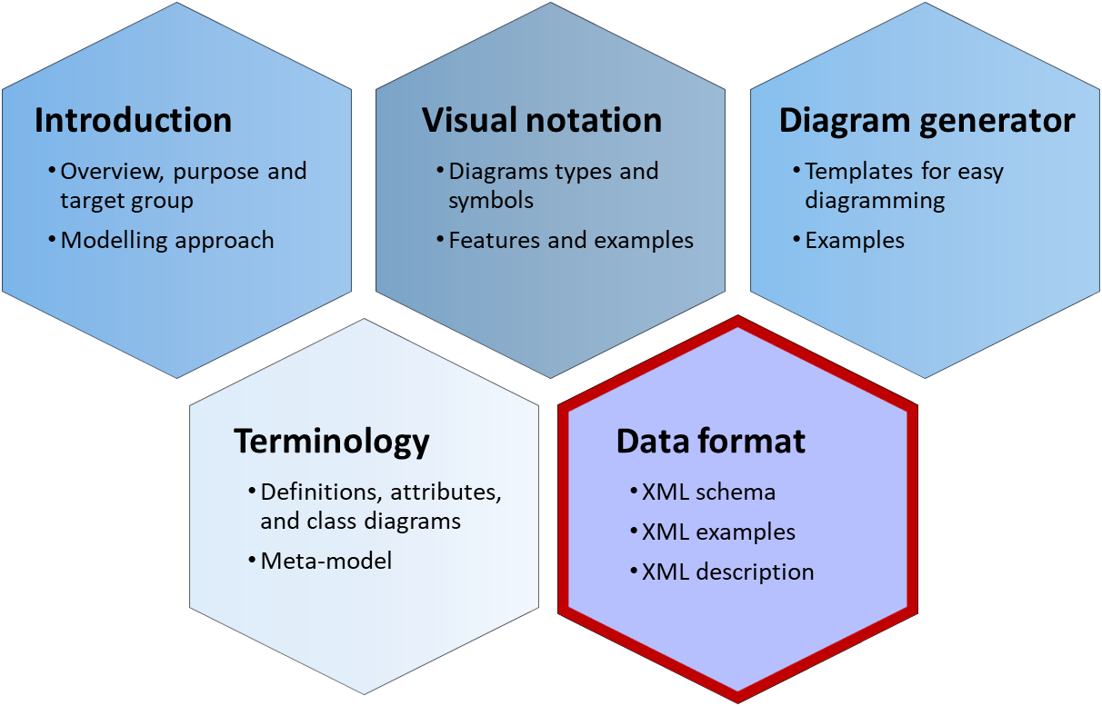


Data format - overview
Structure: The data format is described through an XML Schema Definition (XSD).
Details: The data format is explained through examples in a report (Word document).
Examples: This PowerPoint file contains key information and some illustrative examples, which are also available as XML-files
XSD
DOCX
PPTX
XML

Slide 4
Contents
Readers guide
Who can use this material?
Additional resources
Mandatory data for CJML
Planned journey
Actual journey
Summary
Planned Journey examples:
Case 1: Planned journey for home delivery
Case 2: Planned journey for pick-up
Case 3
Case 4
Actual Journey examples:
Case 1: No Planned Journey, No Deviation, Mandatory Data only
Case 2: With Planned Journey, No Deviation, Mandatory Data only
Case 3: No Planned Journey, With Deviation, Mandatory Data only
Case 4: With Planned Journey, With Deviation, Mandatory Data only
Case 5: Tom - With Planned Journey, No Deviation, Extended data
Case 6: Sarah - With Planned Journey, With Deviation, Extended data

Slide 5


Who can use this material?
CJML v2.0 by SINTEF Digital is licensed under a Creative Commons Attribution-ShareAlike 4.0 International License.
Anyone can use, copy, and transform the material in any medium or format – for any purpose – under the following terms:
Attribution: You must give appropriate credit, provide a link to the license, and indicate if changes were made
ShareAlike: If you remix, transform, or build upon the material, you must distribute your contributions under the same license as the original.
Guidance on how to give appropriate credit can be found here:
https://creativecommons.org/use-remix/
https://wiki.creativecommons.org/wiki/Best_practices_for_attribution
The current version of CJML was released through the research project Smart Journey Mining funded by the Research Council of Norway (grant no. 312198).

Slide 6
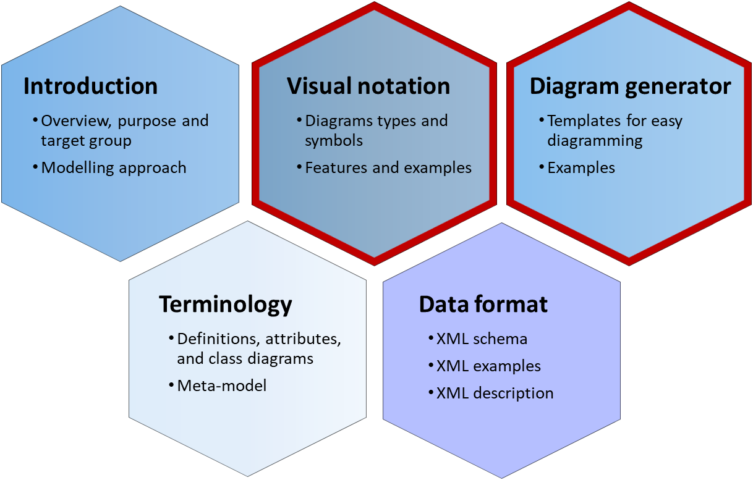
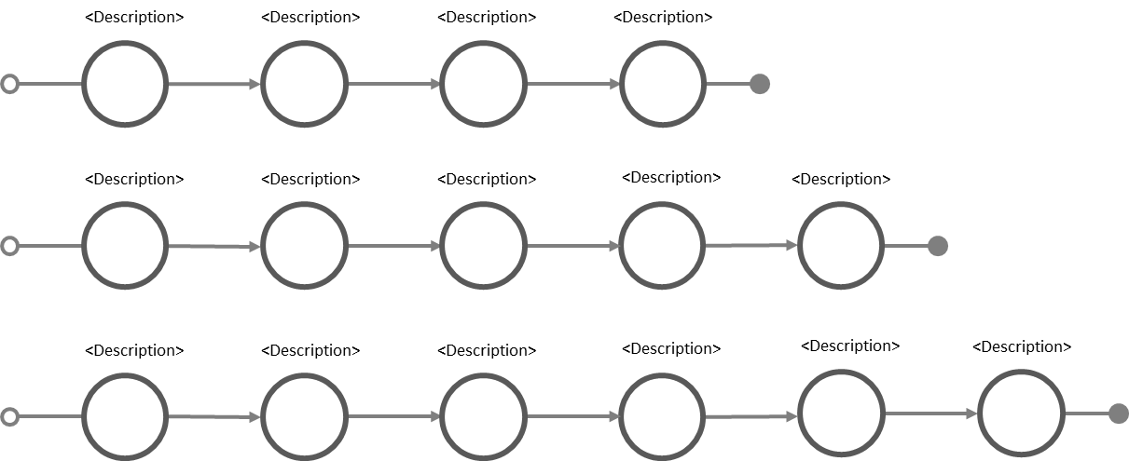
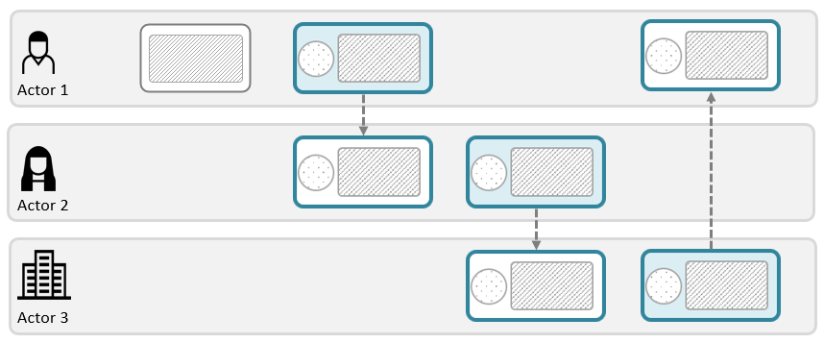
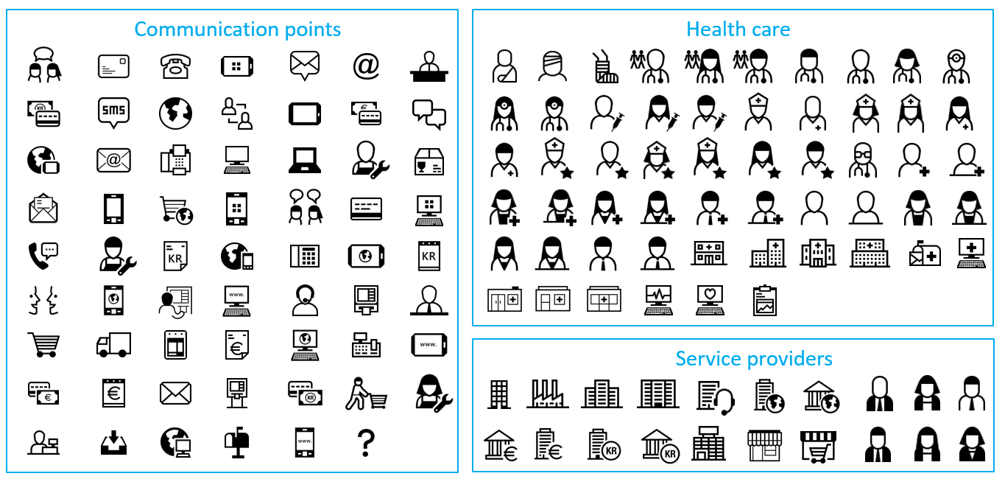
Additional CJML resources
These modules contain support for making diagrams
Please visit the CJML web page www.cjml.no
Alternatives for creating diagrams:
Simply copy-paste elements from the Visual notation slides and modify for your own use
Use the templates in the Diagram generator slides
Download the graphical elements in bitmap or vector format
See the web page for other visual tools
Template – simple journey diagram
Template – journey network diagram
Symbol gallery

Slide 7
Mandatory data
Planned journey
Actual journey
Summary

Slide 8

Planned journey - mandatory
Simple example
T1
T2
customer pays at the cashier
Customer
Customer searches for a book
Cashier
Mandatory for a plannedJourney:
journeyID
actors
endUser & actorID (atleast 1)
serviceProvider & actorID (atleast 1)
touchpoints
at least 2 planned touchpoints
either plannedAction or plannedCommunicationPoint
<CJML version="2.0">
<plannedJourney>
<journeyID>PJ1</journeyID>
<actors>
<endUser actorID ="Customer"/>
<serviceProvider actorID ="Cashier"/>
</actors>
<touchpoints>
<plannedAction>
<touchpointID>T1</touchpointID>
<initiator>
<refersTo actorIDref="Customer"/>
<initiatorLabel>Customer searches for a book</initiatorLabel>
</initiator>
<deltaTime>PT1H</deltaTime>
<touchpointDuration>PT2H</touchpointDuration>
</plannedAction>
<plannedCommunicationPoint>
<touchpointID>T2</touchpointID>
<initiator>
<refersTo actorIDref="Customer"/>
<initiatorLabel>customer pays at the cashier</initiatorLabel>
</initiator>
<receiver>
<refersTo actorIDref="Cashier"/>
<receiverLabel>cashier receives payment</receiverLabel>
</receiver>
<channel>
<channelName>paymentChannel</channelName>
</channel>
<deltaTime>PT1H</deltaTime>
<touchpointDuration>PT5M</touchpointDuration>
</plannedCommunicationPoint>
</touchpoints>
</plannedJourney>
</CJML>
Mandatory for a plannedAction:
touchpointID
initiator
refersTo & actorIDref
initiatorLabel
deltaTime
touchpointDuration
Mandatory for a plannedCommunicationPoint:
touchpointID
initiator
refersTo & actorIDref
initiatorLabel
receiver
refersTo & actorIDref
receiverLabel
channel
channelName
deltaTime
touchpointDuration

Slide 9
Actual journey - mandatory
Simple example
T2
John pays at the cashier
T1
John
John searches for a book
Cashier
John
<CJML version="2.0">
<actualJourney>
<journeyID>AJ1</journeyID>
<actors>
<endUser actorID ="John"/>
<serviceProvider actorID ="Cashier"/>
</actors>
<touchpoints>
<actualAction>
<touchpointID>T1</touchpointID>
<initiator>
<refersTo actorIDref="John"/>
<initiatorLabel>John searches for a book</initiatorLabel>
</initiator>
<timestamps>
<timeCompleted>2002-05-30T09:00:00</timeCompleted>
</timestamps>
</actualAction>
<actualCommunicationPoint>
<touchpointID>T2</touchpointID>
<initiator>
<refersTo actorIDref="Customer"/>
<initiatorLabel>John pays at the cashier</initiatorLabel>
</initiator>
<receiver>
<refersTo actorIDref="Cashier"/>
<receiverLabel>cashier receives payment</receiverLabel>
</receiver>
<channel>
<channelName>paymentChannel</channelName>
</channel>
<timestamps>
<timeCompleted>2002-05-30T09:05:00 </timeCompleted>
</timestamps>
</actualCommunicationPoint>
</touchpoints>
</actualJourney>
</CJML>|
Mandatory for an actualJourney:
journeyID
actors
endUser & actorID (atleast 1)
serviceProvider & actorID (atleast 1)
touchpoints
at least 2 planned touchpoints
either actualAction or actualCommunicationPoint
Mandatory for an actualAction:
touchpointID
initiator
refersTo & actorIDref
initiatorLabel
timestamps
timeCompleted (atleast)
Mandatory for an actualCommunicationPoint:
touchpointID
initiator
refersTo & actorIDref
initiatorLabel
receiver
refersTo & actorIDref
receiverLabel
channel
channelName
timestamps
timeCompleted (atleast)

Slide 10
Summary – mandatory fields
 | Planned Journey | Actual Journey
Journey data | journeyID actors endUser & actorID serviceProvider & actorID touchpoints either plannedAction or plannedCommunicationPoint | journeyID actors endUser & actorID serviceProvider & actorID touchpoints either actualAction or actualCommunicationPoint
Action data | plannedAction: touchpointID initiator refersTo & actorIDref initiatorLabel * deltaTime touchpointDuration | actualAction: touchpointID initiator refersTo & actorIDref initiatorLabel * timestamps * timeCompleted
Communication Point data | plannedCommunicationPoint: touchpointID initiator refersTo & actorIDref initiatorLabel * receiver refersTo & actorIDref receiverLabel * channel channelName deltaTime touchpointDuration | actualCommunicationPoint: touchpointID initiator refersTo & actorIDref initiatorLabel * receiver refersTo & actorIDref receiverLabel * channel channelName timestamps * timeCompleted
NOTE:
initatorLabel* and receiverLabel* are mandatory data for CJML. However, it is difficult to obtain in practice (especially from event logs). Thus, they are not mandatory in the schema level and will not throw an error if they are missing.
timestamps* are also mandatory data for CJML. Similarly, it is relaxed in the schema level (not mandatory) to take into account missing data and the deviation “missing touchpoint”. Note that the special case, “missing touchpoint”, does not contain timestamp.

Slide 11
Planned journey - examples
Case 1 - PJ1: Planned journey for home delivery
Case 2 - PJ2: Planned journey for pick-up

Slide 12





Planned group and individual planned journeys
Planned Journey Group
T4
T5
Receives delivery confirmation
Receives delivery in the mailbox
T1
T2
T3
Orders a book online
Pays through debit card
Receives order confirmation
T4
The planned journey group is decomposed into two planned journeys below.
picks up item from a store
Customer
Online Book Store
Logistics partner
Physical Book Store
Planned Journeys
T1
T2
T3
T4
T5
Orders a book online
Pays through debit card
Receives order confirmation
Receives delivery confirmation
Receives delivery in the mailbox
PJ1
Case 1 - PJ1: Planned journey for home delivery
T1
T2
T3
T4
Orders a book online
Pays through debit card
Receives order confirmation
Picks up item from a store
PJ2
Case 2 - PJ2: Planned journey for pick-up

Slide 13
Case 1 - PJ1: Planned journey for home delivery
touchpointID
T1
T2
T3
T4
T5
Customer
initiatorLabel
(customer is the initiator)
Orders a book online
Pays through debit card
Receives order confirmation
Receives delivery confirmation
Receives delivery in the mailbox
Online Book Store
receiverLabel
(customer is the receiver)
actors
Logistics partner
initiator
(color-coded)
channel
<plannedCommunicationPoint>
<touchpointID>T3</touchpointID>
<initiator>
<refersTo actorIDref="onlineStore"/>
<initiatorLabel>sends order confirmation</initiatorLabel>
</initiator>
<receiver>
<refersTo actorIDref="customer"/>
<receiverLabel>receives order confirmation</receiverLabel>
</receiver>
<channel><channelName>email</channelName></channel>
<deltaTime>PT10M</deltaTime>
<touchpointDuration>PT5M</touchpointDuration>
</plannedCommunicationPoint>
<plannedCommunicationPoint>
<touchpointID>T4</touchpointID>
<initiator>
<refersTo actorIDref="logisticsPartner"/>
<initiatorLabel>sends delivery confirmation</initiatorLabel>
</initiator>
<receiver>
<refersTo actorIDref="customer"/>
<receiverLabel>receives delivery confirmation</receiverLabel>
</receiver>
<channel><channelName>email</channelName></channel>
<deltaTime>PT2H</deltaTime>
<touchpointDuration>PT1H</touchpointDuration>
</plannedCommunicationPoint>
<plannedCommunicationPoint>
<touchpointID>T5</touchpointID>
<initiator>
<refersTo actorIDref="logisticsPartner"/>
<initiatorLabel>sends delivery in the mailbox</initiatorLabel>
</initiator>
<receiver>
<refersTo actorIDref="customer"/>
<receiverLabel>receives delivery in the mailbox</receiverLabel>
</receiver>
<channel><channelName>packageDelivery</channelName></channel>
<deltaTime>P2D</deltaTime>
<touchpointDuration>P1D</touchpointDuration>
</plannedCommunicationPoint>
</touchpoints>
</plannedJourney>
<plannedJourney>
<journeyID>PJ1</journeyID>
<actors>
<endUser actorID ="customer"><actorName>Customer</actorName></endUser>
<serviceProvider actorID ="onlineStore">
<companyName>Online Book Store</companyName>
<providerType>type1_internal_main</providerType>
</serviceProvider>
<serviceProvider actorID ="logisticsPartner">
<companyName>Logistics Partner</companyName>
<providerType>type3_external_thirdParty</providerType>
</serviceProvider>
</actors>
<touchpoints>
<plannedCommunicationPoint>
<touchpointID>T1</touchpointID>
<initiator>
<refersTo actorIDref="customer"/>
<initiatorLabel>orders a book online</initiatorLabel>
</initiator>
<receiver>
<refersTo actorIDref="onlineStore"/>
<receiverLabel>receives customer order</receiverLabel>
</receiver>
<channel><channelName>internetViaPC</channelName></channel>
<deltaTime>PT0H</deltaTime>
<touchpointDuration>PT5M</touchpointDuration>
</plannedCommunicationPoint>
<plannedCommunicationPoint>
<touchpointID>T2</touchpointID>
<initiator>
<refersTo actorIDref="customer"/>
<initiatorLabel>pays through debit card</initiatorLabel>
</initiator>
<receiver>
<refersTo actorIDref="onlineStore"/>
<receiverLabel>receives payment</receiverLabel>
</receiver>
<channel><channelName>paymentChannel</channelName></channel>
<deltaTime>PT20M</deltaTime>
<touchpointDuration>PT5M</touchpointDuration>
</plannedCommunicationPoint>

Slide 14
Case 2 - PJ2: Planned journey for pick-up
T1
T2
T3
T4
Customer
Orders a book online
Pays through debit card
Receives order confirmation
Picks up item from a store
The physical bookstore exists here since PJ2 is a journey for picking-up in a physical store. However, this actor is not an initiator. In the T4 data, you can see that the physical store is the receiver.
Online Book Store
Logistics partner
Physical Book Store
<plannedJourney>
<journeyID>PJ2</journeyID>
<actors>
<endUser actorIDref ="customer"/>
<serviceProvider actorIDref ="onlineStore"/>
<serviceProvider actorIDref ="logisticsPartner"/>
<serviceProvider actorID ="physicalStore">
<companyName>Physical Book Store</companyName>
<providerType>type2_internal_shared</providerType>
</serviceProvider>
</actors>
<touchpoints>
<plannedCommunicationPoint>
<touchpointID>T1</touchpointID>
<initiator>
<refersTo actorIDref="customer"/>
<initiatorLabel>orders a book online</initiatorLabel>
</initiator>
<receiver>
<refersTo actorIDref="onlineStore"/>
<receiverLabel>receives customer order</receiverLabel>
</receiver>
<channel><channelName>internetViaPC</channelName></channel>
<deltaTime>PT0H</deltaTime>
<touchpointDuration>PT5M</touchpointDuration>
</plannedCommunicationPoint>
<plannedCommunicationPoint>
<touchpointID>T2</touchpointID>
<initiator>
<refersTo actorIDref="customer"/>
<initiatorLabel>pays through debit card</initiatorLabel>
</initiator>
<receiver>
<refersTo actorIDref="onlineStore"/>
<receiverLabel>receives payment</receiverLabel>
</receiver>
<channel><channelName>paymentChannel</channelName></channel>
<deltaTime>PT20M</deltaTime>
<touchpointDuration>PT5M</touchpointDuration>
</plannedCommunicationPoint>
<plannedCommunicationPoint>
<touchpointID>T3</touchpointID>
<initiator>
<refersTo actorIDref="onlineStore"/>
<initiatorLabel>sends order confirmation</initiatorLabel>
</initiator>
<receiver>
<refersTo actorIDref="customer"/>
<receiverLabel>receives order confirmation</receiverLabel>
</receiver>
<channel><channelName>email</channelName></channel>
<deltaTime>PT10M</deltaTime>
<touchpointDuration>PT5M</touchpointDuration>
</plannedCommunicationPoint>
<plannedCommunicationPoint>
<touchpointID>T4</touchpointID>
<initiator>
<refersTo actorIDref="customer"/>
<initiatorLabel>picks up item from a store</initiatorLabel>
</initiator>
<receiver>
<refersTo actorIDref="physicalStore"/>
<receiverLabel>gives the item to the customer</receiverLabel>
</receiver>
<channel>
<channelName>faceToFace</channelName>
</channel>
<deltaTime>P1D</deltaTime>
<touchpointDuration>PT5M</touchpointDuration>
</plannedCommunicationPoint>
</touchpoints>
</plannedJourney>

Slide 15
Planned Journey Times
Delta Time
inter- touchpoint starting time
T1
T2
T3
T4
T5
0
20Minutes
10Minutes
2Hours
2Days
Note that “Delta time” is relative to the previous touchpoint.
T1
T2
T3
T4
T5
Orders a book online
Pays through debit card
Receives order confirmation
Receives delivery confirmation
Receives delivery in the mailbox
Touchpoint Duration
Planned duration for each touchpoint
5Minutes
5Minutes
5Minutes
1Hour
1Day

Slide 16
Actual journey - examples
Case 1: AJ1 - No Planned Journey, No Deviation, Mandatory Data only
Case 2: AJ2 - With Planned Journey, No Deviation, Mandatory Data only
Case 3: AJ3 - No Planned Journey, With Deviation, Mandatory Data only
Case 4: AJ4 - With Planned Journey, With Deviation, Mandatory Data only
Case 5: AJ5 - Tom - With Planned Journey, No Deviation, Extended data
Case 6: AJ6 - Sarah - With Planned Journey, With Deviation, Extended data

Slide 17
Case 1: AJ1 - No Planned Journey, No Deviation, Mandatory Data Only
T1
T2
T3
T4
T5
Orders a book online
Pays through debit card
Receives order confirmation
Receives delivery confirmation
Receives delivery in the mailbox
endUser1
Online Book Store
Logistics partner
<!--endUser1 - NO PLANNED JOURNEY, NO DEVIATION, MINIMAL -->
<actualJourney>
<journeyID>AJ1</journeyID>
<actors>
<endUser actorID ="endUser1"/>
<serviceProvider actorIDref ="onlineStore"/>
<serviceProvider actorIDref ="logisticsPartner"/>
</actors>
<touchpoints>
<actualCommunicationPoint>
<touchpointID>T1</touchpointID>
<initiator>
<refersTo actorIDref="endUser1"/>
<initiatorLabel>orders a book online</initiatorLabel>
</initiator>
<receiver>
<refersTo actorIDref="onlineStore"/>
</receiver>
<channel><channelName>internetViaPC</channelName></channel>
<timestamps><timeCompleted>2022-06-30T10:15:00</timeCompleted></timestamps>
</actualCommunicationPoint>
<actualCommunicationPoint>
<touchpointID>T2</touchpointID>
<initiator>
<refersTo actorIDref="endUser1"/>
<initiatorLabel>pays through debit card</initiatorLabel>
</initiator>
<receiver>
<refersTo actorIDref="onlineStore"/>
</receiver>
<channel><channelName>paymentChannel</channelName></channel>
<timestamps><timeCompleted>2022-06-30T10:30:00</timeCompleted></timestamps>
</actualCommunicationPoint>
<actualCommunicationPoint>
<touchpointID>T3</touchpointID>
<initiator>
<refersTo actorIDref="onlineStore"/>
</initiator>
<receiver>
<refersTo actorIDref="endUser1"/>
<receiverLabel>receives order confirmation</receiverLabel>
</receiver>
<channel><channelName>email</channelName></channel>
<timestamps><timeCompleted>2022-06-30T12:00:00</timeCompleted></timestamps>
</actualCommunicationPoint>
<actualCommunicationPoint>
<touchpointID>T4</touchpointID>
<initiator>
<refersTo actorIDref="logisticsPartner"/>
</initiator>
<receiver>
<refersTo actorIDref="endUser1"/>
<receiverLabel>receives delivery confirmation</receiverLabel>
</receiver>
<channel><channelName>email</channelName></channel>
<timestamps><timeCompleted>2022-06-30T13:30:00</timeCompleted></timestamps>
</actualCommunicationPoint>
<actualCommunicationPoint>
<touchpointID>T5</touchpointID>
<initiator>
<refersTo actorIDref="logisticsPartner"/>
</initiator>
<receiver>
<refersTo actorIDref="endUser1"/>
<receiverLabel>receives delivery in the mailbox</receiverLabel>
</receiver>
<channel><channelName>packageDelivery</channelName></channel>
<timestamps><timeCompleted>2022-07-01T10:30:00</timeCompleted></timestamps>
</actualCommunicationPoint>
</touchpoints>
</actualJourney>

Slide 18
Case 2: AJ1 - With Planned Journey, No Deviation, Mandatory Data Only
T1
T2
T3
T4
T5
Orders a book online
Pays through debit card
Receives order confirmation
Receives delivery confirmation
Receives delivery in the mailbox
endUser2
Online Book Store
Logistics partner
<!--endUser2 - WITH PLANNED JOURNEY, NO DEVIATION, MINIMAL-->
<actualJourney>
<journeyID>AJ2</journeyID>
<journeyStatus>completed</journeyStatus> <!--status exist because there is a planned journey to compare with-->
<plannedReference>PJ1</plannedReference> <!--this is the only difference from AJ1 since both are minimal and no deviation -->
<actors>
<endUser actorID ="endUser2"/>
<serviceProvider actorIDref ="onlineStore"/>
<serviceProvider actorIDref ="logisticsPartner"/>
</actors>
<touchpoints>
<actualCommunicationPoint>
<touchpointID>T1</touchpointID>
<initiator>
<refersTo actorIDref="endUser2"/>
<initiatorLabel>orders a book online</initiatorLabel>
</initiator>
<receiver>
<refersTo actorIDref="onlineStore"/>
</receiver>
<channel>
<channelName>internetViaPC</channelName>
</channel>
<timestamps><timeCompleted>2022-06-30T10:15:00</timeCompleted></timestamps>
</actualCommunicationPoint>
<actualCommunicationPoint>
<touchpointID>T2</touchpointID>
<initiator>
<refersTo actorIDref="endUser2"/>
<initiatorLabel>pays through debit card</initiatorLabel>
</initiator>
<receiver>
<refersTo actorIDref="onlineStore"/>
</receiver>
<channel>
<channelName>paymentChannel</channelName>
</channel>
<timestamps><timeCompleted>2022-06-30T10:30:00</timeCompleted></timestamps>
</actualCommunicationPoint>
<actualCommunicationPoint>
<touchpointID>T3</touchpointID>
<initiator>
<refersTo actorIDref="onlineStore"/>
</initiator>
<receiver>
<refersTo actorIDref="endUser2"/>
<receiverLabel>receives order confirmation</receiverLabel>
</receiver>
<channel>
<channelName>email</channelName>
</channel>
<timestamps><timeCompleted>2022-06-30T12:00:00</timeCompleted></timestamps>
</actualCommunicationPoint>
<actualCommunicationPoint>
<touchpointID>T4</touchpointID>
<initiator>
<refersTo actorIDref="logisticsPartner"/>
</initiator>
<receiver>
<refersTo actorIDref="endUser2"/>
<receiverLabel>receives delivery confirmation</receiverLabel>
</receiver>
<channel><channelName>email</channelName></channel>
<timestamps><timeCompleted>2022-06-30T13:30:00</timeCompleted></timestamps>
</actualCommunicationPoint>
<actualCommunicationPoint>
<touchpointID>T5</touchpointID>
<initiator>
<refersTo actorIDref="logisticsPartner"/>
</initiator>
<receiver>
<refersTo actorIDref="endUser2"/>
<receiverLabel>receives delivery in the mailbox</receiverLabel>
</receiver>
<channel><channelName>packageDelivery</channelName></channel>
<timestamps><timeCompleted>2022-07-01T10:30:00</timeCompleted></timestamps>
</actualCommunicationPoint>
</touchpoints>
</actualJourney>

Slide 19
Case 3: AJ3 - No Planned Journey, With Deviation, Mandatory Data Only
not considered a deviation (no planned journey)
T1
T2
T3
T4
T5
T6
Orders a book online
Pays through debit card
Customer's card was declined
Receives order confirmation
Receives delivery confirmation
Receives delivery in the mailbox
endUser3
Online Book Store
Logistics partner
<!--endUser3 - NO PLANNED JOURNEY, WITH DEVIATION, MINIMAL -->
<actualJourney>
<journeyID>AJ3</journeyID>
<actors>
<endUser actorID ="endUser3"/>
<serviceProvider actorIDref ="onlineStore"/>
<serviceProvider actorIDref ="logisticsPartner"/>
</actors>
<touchpoints>
<actualCommunicationPoint>
<touchpointID>T1</touchpointID>
<initiator>
<refersTo actorIDref="endUser3"/>
<initiatorLabel>orders a book online</initiatorLabel>
</initiator>
<receiver><refersTo actorIDref="onlineStore"/></receiver>
<channel><channelName>internetViaPC</channelName></channel>
<timestamps><timeCompleted>2022-06-30T10:15:00</timeCompleted></timestamps>
</actualCommunicationPoint>
<!--This is a deviation (D1) - but doesn’t refer to planned journey, so there is nothing to comply with, thus, its not treated as a deviation -->
<actualCommunicationPoint>
<touchpointID>T2</touchpointID>
<initiator>
<refersTo actorIDref="endUser3"/>
<initiatorLabel>Customer's card was declined</initiatorLabel>
</initiator>
<receiver><refersTo actorIDref="onlineStore"/></receiver>
<channel><channelName>paymentChannel</channelName></channel>
<timestamps><timeCompleted>2022-07-01T10:15:00</timeCompleted></timestamps>
</actualCommunicationPoint>
<!--This is should have been T2, if there is a planned journey -->
<actualCommunicationPoint>
<touchpointID>T3</touchpointID>
<initiator>
<refersTo actorIDref="endUser3"/>
<initiatorLabel>pays through debit card</initiatorLabel>
</initiator>
<receiver><refersTo actorIDref="onlineStore"/></receiver>
<channel><channelName>paymentChannel</channelName></channel>
<timestamps><timeCompleted>2022-06-30T10:30:00</timeCompleted></timestamps>
</actualCommunicationPoint>
<actualCommunicationPoint>
<touchpointID>T4</touchpointID>
<initiator>
<refersTo actorIDref="onlineStore"/>
</initiator>
<receiver>
<refersTo actorIDref="endUser3"/>
<receiverLabel>receives order confirmation</receiverLabel>
</receiver>
<channel><channelName>email</channelName></channel>
<timestamps><timeCompleted>2022-06-30T12:00:00</timeCompleted></timestamps>
</actualCommunicationPoint>
<actualCommunicationPoint>
<touchpointID>T5</touchpointID>
<initiator>
<refersTo actorIDref="logisticsPartner"/>
</initiator>
<receiver>
<refersTo actorIDref="endUser3"/>
<receiverLabel>receives delivery confirmation</receiverLabel>
</receiver>
<channel>
<channelName>email</channelName>
</channel>
<timestamps><timeCompleted>2022-06-30T13:30:00</timeCompleted></timestamps>
</actualCommunicationPoint>
<actualCommunicationPoint>
<touchpointID>T6</touchpointID>
<initiator>
<refersTo actorIDref="logisticsPartner"/>
</initiator>
<receiver>
<refersTo actorIDref="endUser3"/>
<receiverLabel>receives delivery in the mailbox</receiverLabel>
</receiver>
<channel><channelName>packageDelivery</channelName></channel>
<timestamps><timeCompleted>2022-07-01T10:30:00</timeCompleted></timestamps>
</actualCommunicationPoint>
</touchpoints>
</actualJourney>

Slide 20
Case 4: AJ4 - With Planned Journey, With Deviation, Mandatory Data Only
T1
T2
T3
T4
T5
Orders a book online
Pays through debit card
Receives order confirmation
Receives delivery confirmation
Receives delivery in the mailbox
endUser4
Online Book Store
Logistics partner
<!--endUser4 - WITH PLANNED JOURNEY, WITH DEVIATION, MINIMAL -->
<actualJourney>
<journeyID>AJ4</journeyID>
<journeyStatus>completed</journeyStatus>
<plannedReference>PJ1</plannedReference> <!-- this is needed if there is a planned journey needed -->
<complianceContent>false</complianceContent> <!-- since it is minimal, only the "false" values are need-->
<actors>
<endUser actorID ="endUser4"/> <serviceProvider actorIDref ="onlineStore"/> <serviceProvider actorIDref ="logisticsPartner"/>
</actors>
<touchpoints>
<actualCommunicationPoint>
<touchpointID>T1</touchpointID>
<initiator>
<refersTo actorIDref="endUser4"/>
<initiatorLabel>orders a book online</initiatorLabel>
</initiator>
<receiver><refersTo actorIDref="onlineStore"/></receiver>
<channel><channelName>internetViaPC</channelName></channel>
<timestamps><timeCompleted>2022-06-30T10:15:00</timeCompleted></timestamps>
</actualCommunicationPoint>
<!--This is a deviation, unlike the previous case, this is really treated as deviation with numbering starting at D1 -->
<actualCommunicationPoint>
<touchpointID>D1</touchpointID> <!--Deviation numbering starts at D1 -->
<compliance>failing</compliance> <!--What type of deviation -->
<initiator>
<refersTo actorIDref="endUser4"/>
<initiatorLabel>Customer's card was declined</initiatorLabel>
</initiator>
<receiver><refersTo actorIDref="onlineStore"/></receiver>
<channel><channelName>paymentChannel</channelName></channel>
<timestamps><timeCompleted>2022-07-01T10:15:00</timeCompleted></timestamps>
</actualCommunicationPoint>
<!--Unlike the previous (which becomes T3), this is back to T2 since it refers to the planned journey -->
<actualCommunicationPoint>
<touchpointID>T2</touchpointID>
<initiator>
<refersTo actorIDref="endUser4"/>
<initiatorLabel>pays through debit card</initiatorLabel>
</initiator>
<receiver><refersTo actorIDref="onlineStore"/></receiver>
<channel><channelName>paymentChannel</channelName></channel>
<timestamps><timeCompleted>2022-06-30T10:30:00</timeCompleted></timestamps>
</actualCommunicationPoint>
D1
Customer's card was declined
a deviation! since there is a planned journey to refer with
(T2 in the previous case)
<<actualCommunicationPoint>
<touchpointID>T3</touchpointID>
<initiator><refersTo actorIDref="onlineStore"/></initiator>
<receiver>
<refersTo actorIDref="endUser4"/>
<receiverLabel>receives order confirmation</receiverLabel>
</receiver>
<channel><channelName>email</channelName></channel>
<timestamps><timeCompleted>2022-06-30T12:00:00</timeCompleted></timestamps>
</actualCommunicationPoint>
<actualCommunicationPoint>
<touchpointID>T4</touchpointID>
<initiator>
<refersTo actorIDref="logisticsPartner"/>
</initiator>
<receiver>
<refersTo actorIDref="endUser4"/>
<receiverLabel>receives delivery confirmation</receiverLabel>
</receiver>
<channel><channelName>email</channelName></channel>
<timestamps><timeCompleted>2022-06-30T13:30:00</timeCompleted></timestamps>
</actualCommunicationPoint>
<actualCommunicationPoint>
<touchpointID>T5</touchpointID>
<initiator>
<refersTo actorIDref="logisticsPartner"/>
</initiator>
<receiver>
<refersTo actorIDref="endUser4"/>
<receiverLabel>receives delivery in the mailbox</receiverLabel>
</receiver>
<channel><channelName>packageDelivery</channelName></channel>
<timestamps><timeCompleted>2022-07-01T10:30:00</timeCompleted></timestamps>
</actualCommunicationPoint>
</touchpoints>
</actualJourney>

Slide 21
Case 5: AJ5 - Tom - With Planned Journey, No Deviation, Extended Data
T1
T2
T3
T4
T5
Orders a book online
Pays through debit card
Receives order confirmation
Receives delivery confirmation
Receives delivery in the mailbox
Tom
Online Book Store
Logistics partner
Tom
<!--endUser5- TOM - WITH PLANNED JOURNEY, NO DEVIATION, WITH SOME ADDITION (NOT MINIMAL) -->
<!--addition: preferences, frustrations, preferredChannels, experience, journey summary, compliance,
both labels (initiator and receiver), complete times -->
<actualJourney>
<journeyID>AJ5</journeyID>
<journeyTitle>This is the title of the journey</journeyTitle>
<journeyShortSummary>A short journey summary</journeyShortSummary>
<journeyLongSummary>A very very long journey description</journeyLongSummary>
<journeyStatus>completed</journeyStatus>
<plannedReference>PJ1</plannedReference>
<complianceContent>true</complianceContent>
<complianceSequence>true</complianceSequence>
<complianceTiming>true</complianceTiming>
<journeyExperience>
<experienceDescription>perfect experience! no deviations!</experienceDescription>
<experienceRating>5</experienceRating>
</journeyExperience>
<actors>
<endUser actorID ="endUser5">
<actorName>Tom</actorName>
<preferences>fantasy books</preferences>
<frustrations>horror books</frustrations>
<preferredChannels>faceToFace</preferredChannels>
<customer/>
</endUser>
<serviceProvider actorIDref ="onlineStore"/>
<serviceProvider actorIDref ="logisticsPartner"/>
</actors>
<touchpoints>
<actualCommunicationPoint>
<touchpointID>T1</touchpointID>
<initiator>
<refersTo actorIDref="endUser5"/>
<initiatorLabel>orders a book online</initiatorLabel>
</initiator>
<receiver>
<refersTo actorIDref="onlineStore"/>
<receiverLabel>receives customer order</receiverLabel>
</receiver>
<channel><channelName>internetViaPC</channelName></channel>
<>timestamps>
<timeStarted>2022-06-30T10:00:00</timeStarted>
<timeCompleted>2022-06-30T10:15:00</timeCompleted>
</timestamps
<touchpointExperience>
<experienceDescription>easy ordering</experienceDescription>
<experienceRating>5</experienceRating>
</touchpointExperience>
</actualCommunicationPoint>
<actualCommunicationPoint>
<touchpointID>T2</touchpointID>
<initiator>
<refersTo actorIDref="endUser5"/>
<initiatorLabel>pays through debit card</initiatorLabel>
</initiator>
<receiver>
<refersTo actorIDref="onlineStore"/>
<receiverLabel>receives payment</receiverLabel>
</receiver>
<channel><channelName>paymentChannel</channelName></channel>
<timestamps>
<timeStarted>2022-06-30T10:25:00</timeStarted>
<timeCompleted>2022-06-30T10:30:00</timeCompleted>
</timestamps>
</actualCommunicationPoint>

Slide 22
continuation:
<actualCommunicationPoint>
<touchpointID>T3</touchpointID>
<initiator>
<refersTo actorIDref="onlineStore"/>
<initiatorLabel>sends order confirmation</initiatorLabel>
</initiator>
<receiver>
<refersTo actorIDref="endUser5"/>
<receiverLabel>receives order confirmation</receiverLabel>
</receiver>
<channel>
<channelName>email</channelName>
</channel>
<timestamps>
<timeOriginated>2002-05-30T11:00:00</timeOriginated>
<timeReceived>2002-05-30T11:30:00</timeReceived>
<timeConsumed>2022-06-30T12:00:00</timeConsumed>
</timestamps>
</actualCommunicationPoint>
<actualCommunicationPoint>
<touchpointID>T4</touchpointID>
<initiator>
<refersTo actorIDref="logisticsPartner"/>
<initiatorLabel>sends delivery confirmation</initiatorLabel>
</initiator>
<receiver>
<refersTo actorIDref="endUser5"/>
<receiverLabel>receives delivery confirmation</receiverLabel>
</receiver>
<channel>
<channelName>email</channelName>
</channel>
<timestamps>
<timeOriginated>2022-06-30T13:00:00</timeOriginated>
<timeReceived>2022-06-30T13:01:00</timeReceived>
<timeConsumed>2022-06-30T13:30:00</timeConsumed>
</timestamps>
</actualCommunicationPoint>
<actualCommunicationPoint>
<touchpointID>T5</touchpointID>
<initiator>
<refersTo actorIDref="logisticsPartner"/>
<initiatorLabel>sends delivery in the mailbox</initiatorLabel>
</initiator>
<receiver>
<refersTo actorIDref="endUser5"/>
<receiverLabel>receives delivery in the mailbox</receiverLabel>
</receiver>
<channel>
<channelName>packageDelivery</channelName>
</channel>
<timestamps>
<timeOriginated>2022-07-01T10:00:00</timeOriginated>
<timeReceived>2022-07-01T10:01:00</timeReceived>
<timeConsumed>2022-07-01T10:30:00</timeConsumed>
</timestamps>
<touchpointExperience>
<experienceDescription>package arrived as expected</experienceDescription>
<experienceRating>4</experienceRating>
</touchpointExperience>
</actualCommunicationPoint>
</touchpoints>
</actualJourney>

Slide 23
Case 6: AJ6 - Sarah - With Planned Journey, With Deviation, Extended Data
T1
T2
T3
T4
T5
Orders a book online
Pays through debit card
Receives order confirmation
Receives delivery confirmation
Receives delivery in the mailbox
Sarah
Online Book Store
Logistics partner
Sarah
<touchpoints>
<actualCommunicationPoint>
<touchpointID>T1</touchpointID>
<initiator>
<refersTo actorIDref="endUser6"/>
<initiatorLabel>orders a book online</initiatorLabel>
</initiator>
<receiver>
<refersTo actorIDref="onlineStore"/>
<receiverLabel>receives customer order</receiverLabel>
</receiver>
<channel><channelName>internetViaPC</channelName></channel>
<timestamps>
<timeStarted>2022-07-01T10:00:00</timeStarted>
<timeCompleted>2022-07-01T10:05:00</timeCompleted>
</timestamps>
</actualCommunicationPoint>
<actualCommunicationPoint>
<touchpointID>D1</touchpointID>
<compliance>failing</compliance>
<initiator>
<refersTo actorIDref="endUser6"/>
<initiatorLabel>Customer's card was declined</initiatorLabel>
</initiator>
<receiver>
<refersTo actorIDref="onlineStore"/>
<receiverLabel>payment not received</receiverLabel>
</receiver>
<channel>
<channelName>paymentChannel</channelName>
</channel>
<timestamps>
<timeStarted>2022-07-01T10:10:00</timeStarted>
<timeCompleted>2022-07-01T10:15:00</timeCompleted>
</timestamps>
<touchpointExperience>
<experienceDescription>I dont understand why it failed</experienceDescription>
<experienceRating>1</experienceRating>
</touchpointExperience>
</actualCommunicationPoint>
D1
Customer's debit Card was declined
<!--endUser6- SARAH - WITH PLANNED JOURNEY, WITH DEVIATION, WITH SOME ADDITION (NOT MINIMAL) -->
<!--addition: enduser preferences, frustrations, preferredChannels, user experience, journey summary, compliance values,
both labels (initiator and receiver), complete times -->
<!-- some analysis but not for Ragnhild -->
<actualJourney>
<journeyID>AJ6</journeyID>
<journeyTitle>This is the title of the journey</journeyTitle>
<journeyShortSummary>A short journey summary</journeyShortSummary>
<journeyLongSummary>A very very long journey description</journeyLongSummary>
<journeyStatus>completed</journeyStatus>
<plannedReference>PJ1</plannedReference>
<complianceContent>false</complianceContent>
<complianceSequence>true</complianceSequence>
<complianceTiming>true</complianceTiming>
<journeyExperience>
<experienceDescription>nothing special</experienceDescription>
<experienceRating>3</experienceRating>
</journeyExperience>
<actors>
<endUser actorID ="endUser6">
<actorName>Sarah</actorName>
<preferences>fantasy books</preferences>
<frustrations>horror books</frustrations>
<preferredChannels>faceToFace</preferredChannels>
<customer/>
</endUser>
<serviceProvider actorIDref ="onlineStore"/>
<serviceProvider actorIDref ="logisticsPartner"/>
</actors>

Slide 24
continuation:
<actualCommunicationPoint>
<touchpointID>T2</touchpointID>
<initiator>
<refersTo actorIDref="endUser6"/>
<initiatorLabel>pays through debit card</initiatorLabel>
</initiator>
<receiver>
<refersTo actorIDref="onlineStore"/>
<receiverLabel>receives payment</receiverLabel>
</receiver>
<channel><channelName>paymentChannel</channelName></channel>
<timestamps>
<timeStarted>2022-07-01T10:20:00</timeStarted>
<timeCompleted>2022-07-01T10:25:00</timeCompleted>
</timestamps>
</actualCommunicationPoint>
<actualCommunicationPoint>
<touchpointID>T3</touchpointID>
<initiator>
<refersTo actorIDref="onlineStore"/>
<initiatorLabel>sends order confirmation</initiatorLabel>
</initiator>
<receiver>
<refersTo actorIDref="endUser6"/>
<receiverLabel>receives order confirmation</receiverLabel>
</receiver>
<channel><channelName>email</channelName></channel>
<timestamps>
<timeOriginated>2022-07-01T12:00:00</timeOriginated>
<timeReceived>2022-07-01T12:01:00</timeReceived>
<timeConsumed>2022-07-01T12:30:00</timeConsumed>
</timestamps>
</actualCommunicationPoint>
<actualCommunicationPoint>
<touchpointID>T4</touchpointID>
<initiator>
<refersTo actorIDref="logisticsPartner"/>
<initiatorLabel>sends delivery confirmation</initiatorLabel>
</initiator>
<receiver>
<refersTo actorIDref="endUser6"/>
<receiverLabel>receives delivery confirmation</receiverLabel>
</receiver>
<channel><channelName>email</channelName></channel>
<timestamps>
<timeOriginated>2022-07-01T14:30:00</timeOriginated>
<timeReceived>2022-07-01T14:31:00</timeReceived>
<timeConsumed>2022-07-01T15:00:00</timeConsumed>
</timestamps>
</actualCommunicationPoint>
<actualCommunicationPoint>
<touchpointID>T5</touchpointID>
<initiator>
<refersTo actorIDref="logisticsPartner"/>
<initiatorLabel>sends delivery in the mailbox</initiatorLabel>
</initiator>
<receiver>
<refersTo actorIDref="endUser6"/>
<receiverLabel>receives delivery in the mailbox</receiverLabel>
</receiver>
<channel>
<channelName>packageDelivery</channelName>
</channel>
<timestamps>
<timeOriginated>2022-07-02T16:00:00</timeOriginated>
<timeReceived>2022-07-02T16:05:00</timeReceived>
<timeConsumed>2022-07-02T17:00:00</timeConsumed>
</timestamps>
<touchpointLevelAnalysis>
<literallyAnyField>0.99</literallyAnyField>
<anotherField>super good prediction for package arrival</anotherField>
<someTouchpointLevelResult>TRUE</someTouchpointLevelResult>
</touchpointLevelAnalysis>
</actualCommunicationPoint>
</touchpoints>
<journeyLevelAnalysis>
<anyField>predicted some deviations will happen</anyField>
<literallyAnyField>0.95</literallyAnyField>
</journeyLevelAnalysis>
</actualJourney>

